Slide 1
Green Crab Invasion –
A Community Action Approach to Resilience Against Invasive Species in
Southern Southeast Alaska Confirmation
Metlakatla Indian Community

Slide 2
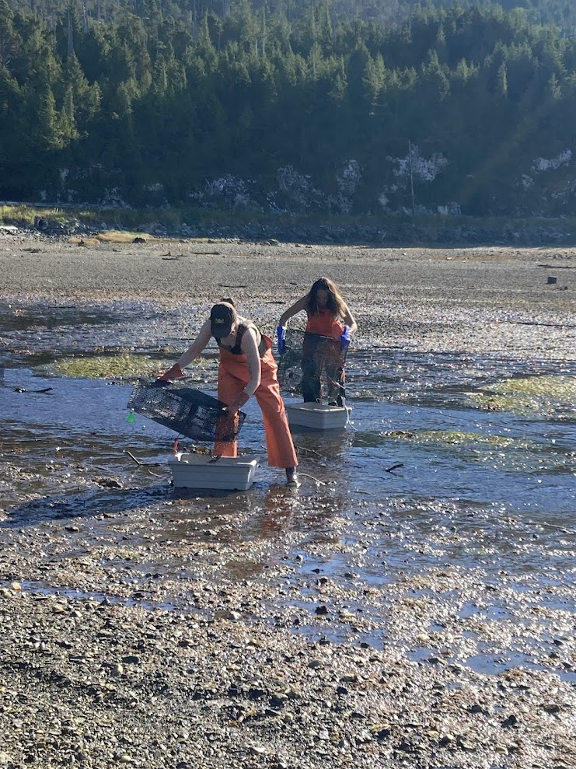
Why are European Green Crab so Bad?
Invasive European Green Crabs (EGC) have been blamed for the collapse of the soft-shell clam industry in Maine. Which means EGC pose a risk to Alaska commercial, subsistence and personal use fisheries.
EGC is listed as one of the top ten worst invasive species in the world.
Behavior: Burrowing impacts eelgrass, coastal erosion, with impacts on salmonids, herring, native crabs
High fecundity: 100,000+ larvae per clutch, multiple times a year
MIC immediately recognized EGC as a concern when it was declared an emergency by several tribal nations in Washington and British Columbia.

Slide 3
Background of European Green Crab on Annette Islands Reserve
2022
2023
2024
First live EGC caught July 22
Detections only in Tamgas Bay
773 total specimens for the year
Began trapping year-round
Detections expanding but only in Tamgas Bay
2,133 total specimens for the year
Trapping year-round
Detections expanded to 3 new sites
Found many young-of-the-year in September
1,865 total specimens for the year

Slide 4
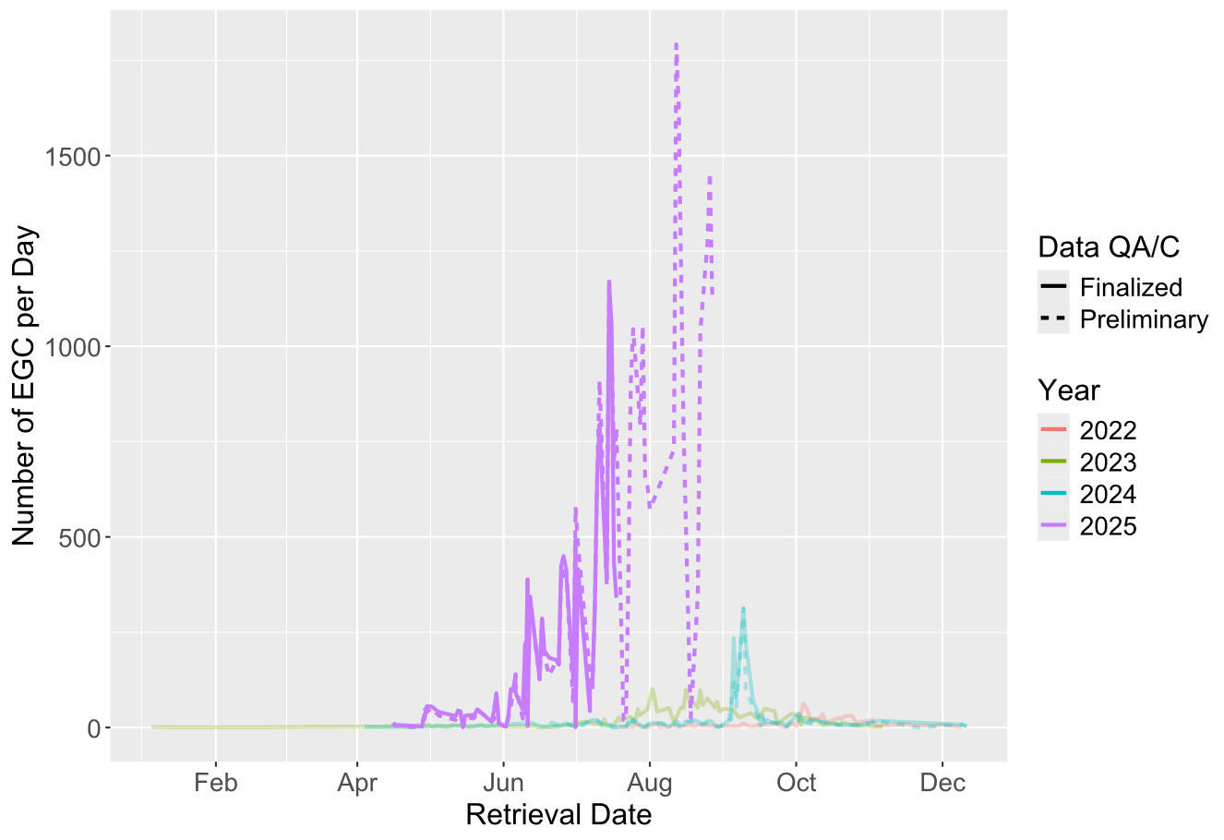
EGC in 2025
Total live catch from 2024 was 1,460
In 2025, 33,000+ EGC have been removed from Annette Islands Reserve
This includes the 260+ live individuals removed from areas like Gravina Island, and Prince of Wales.
In 2025 over 9,500 traps have been checked, with at least five dedicated field staff.

Slide 5
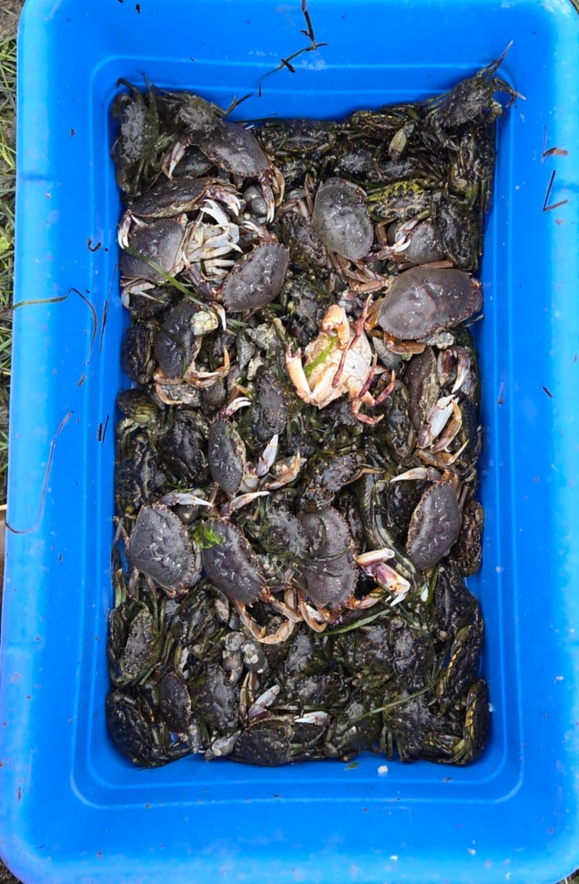
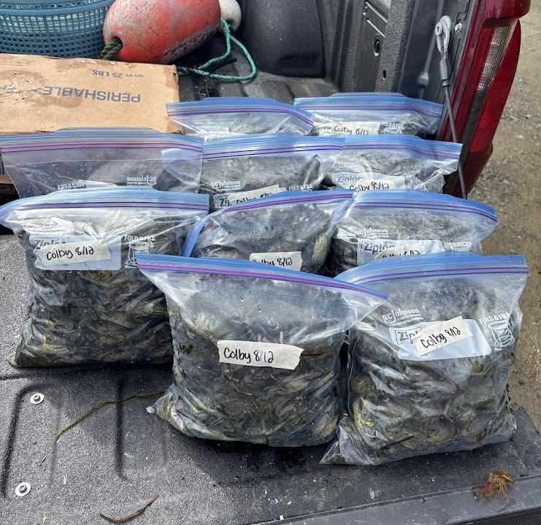
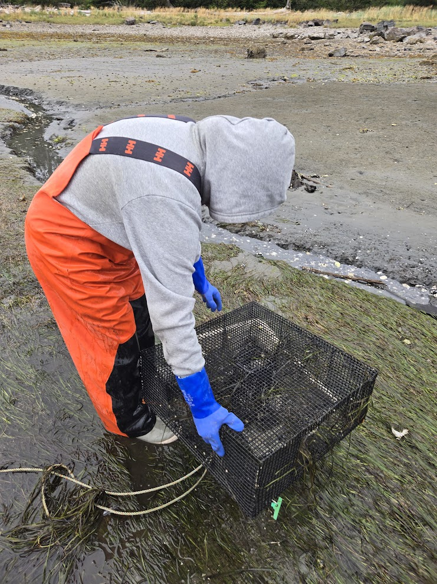
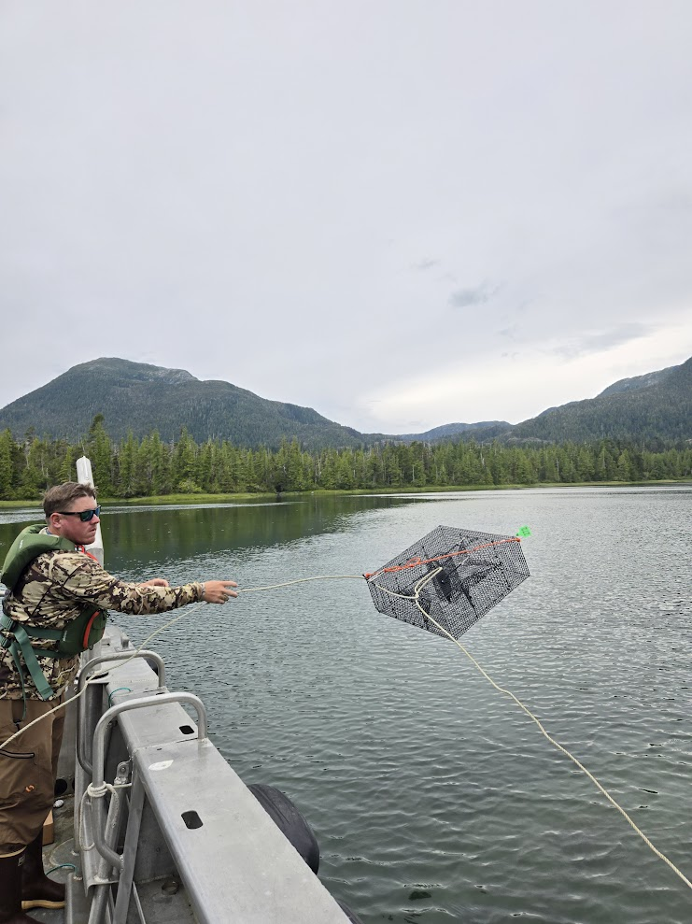
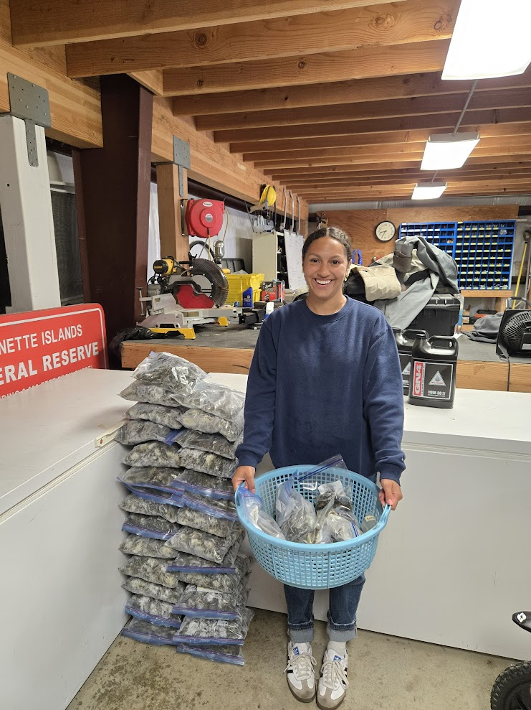
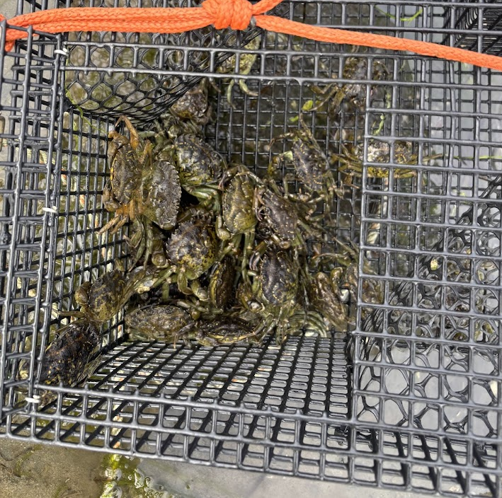
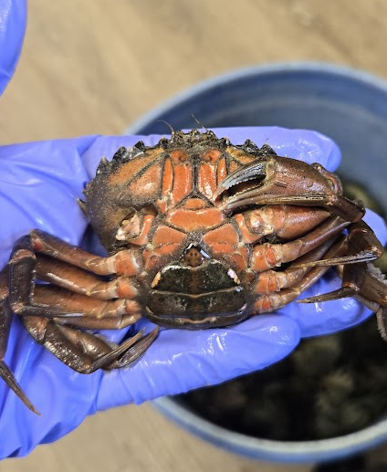
In the Field

Slide 6
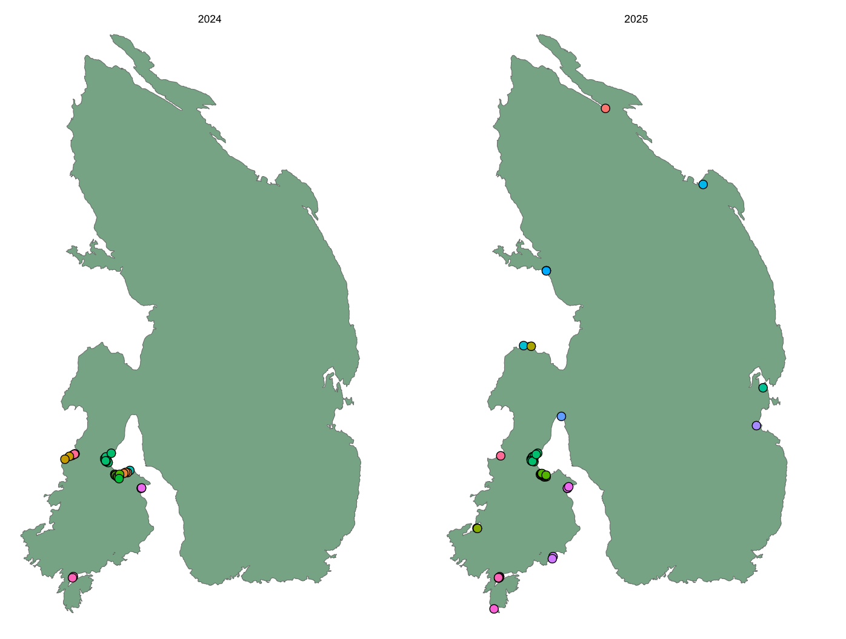
Why so many new sites in 2025?
2024
2025
2023-2024 El Niño was strong enough to increase recruitment in 2024, which led to a large increase in YOTY at the end of2024 and early 2025.

Slide 7
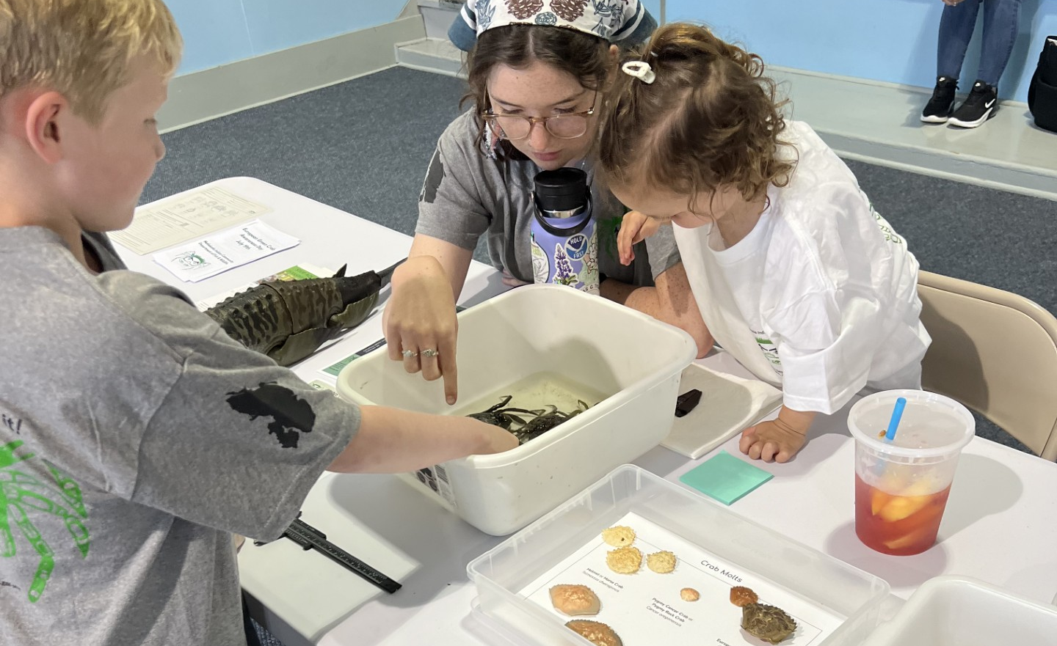
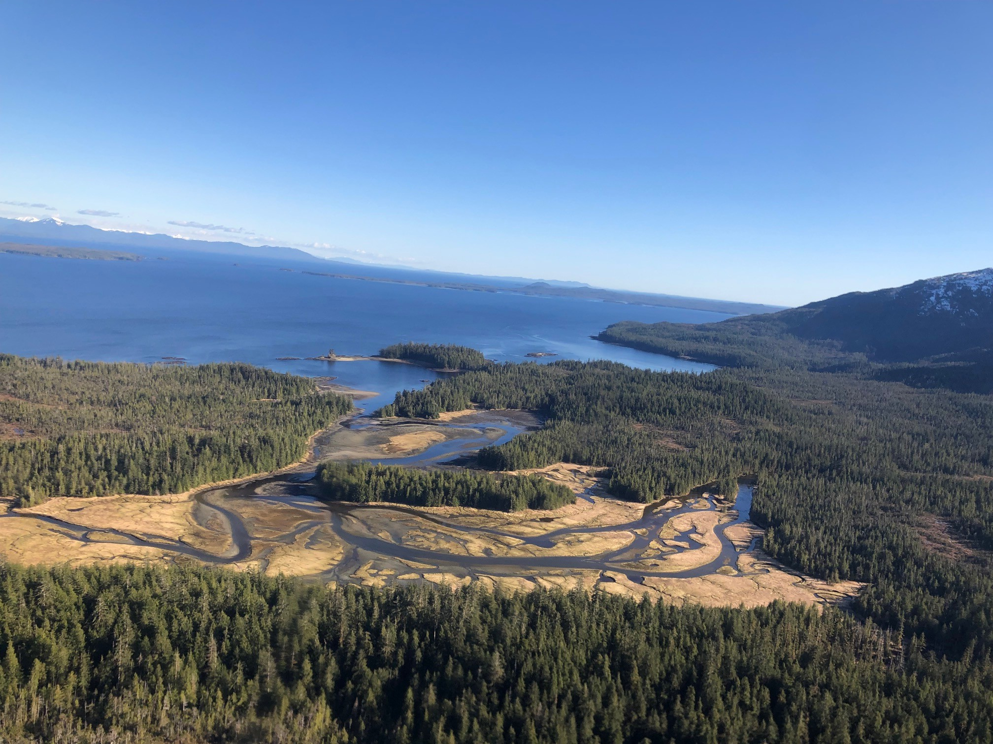
Next Steps
To maintain our high level of community outreach and education. It is highly effective
To prioritize protection of subsistence and commercial resources
Juvenile salmon habitat
Dungeness crab habitat
Valued eel grass and sea asparagus
Shellfish such as clams and cockles
To continue to network with the tribes and communities to reduce the impacts from unmanaged EGC in AK waters.

Slide 8
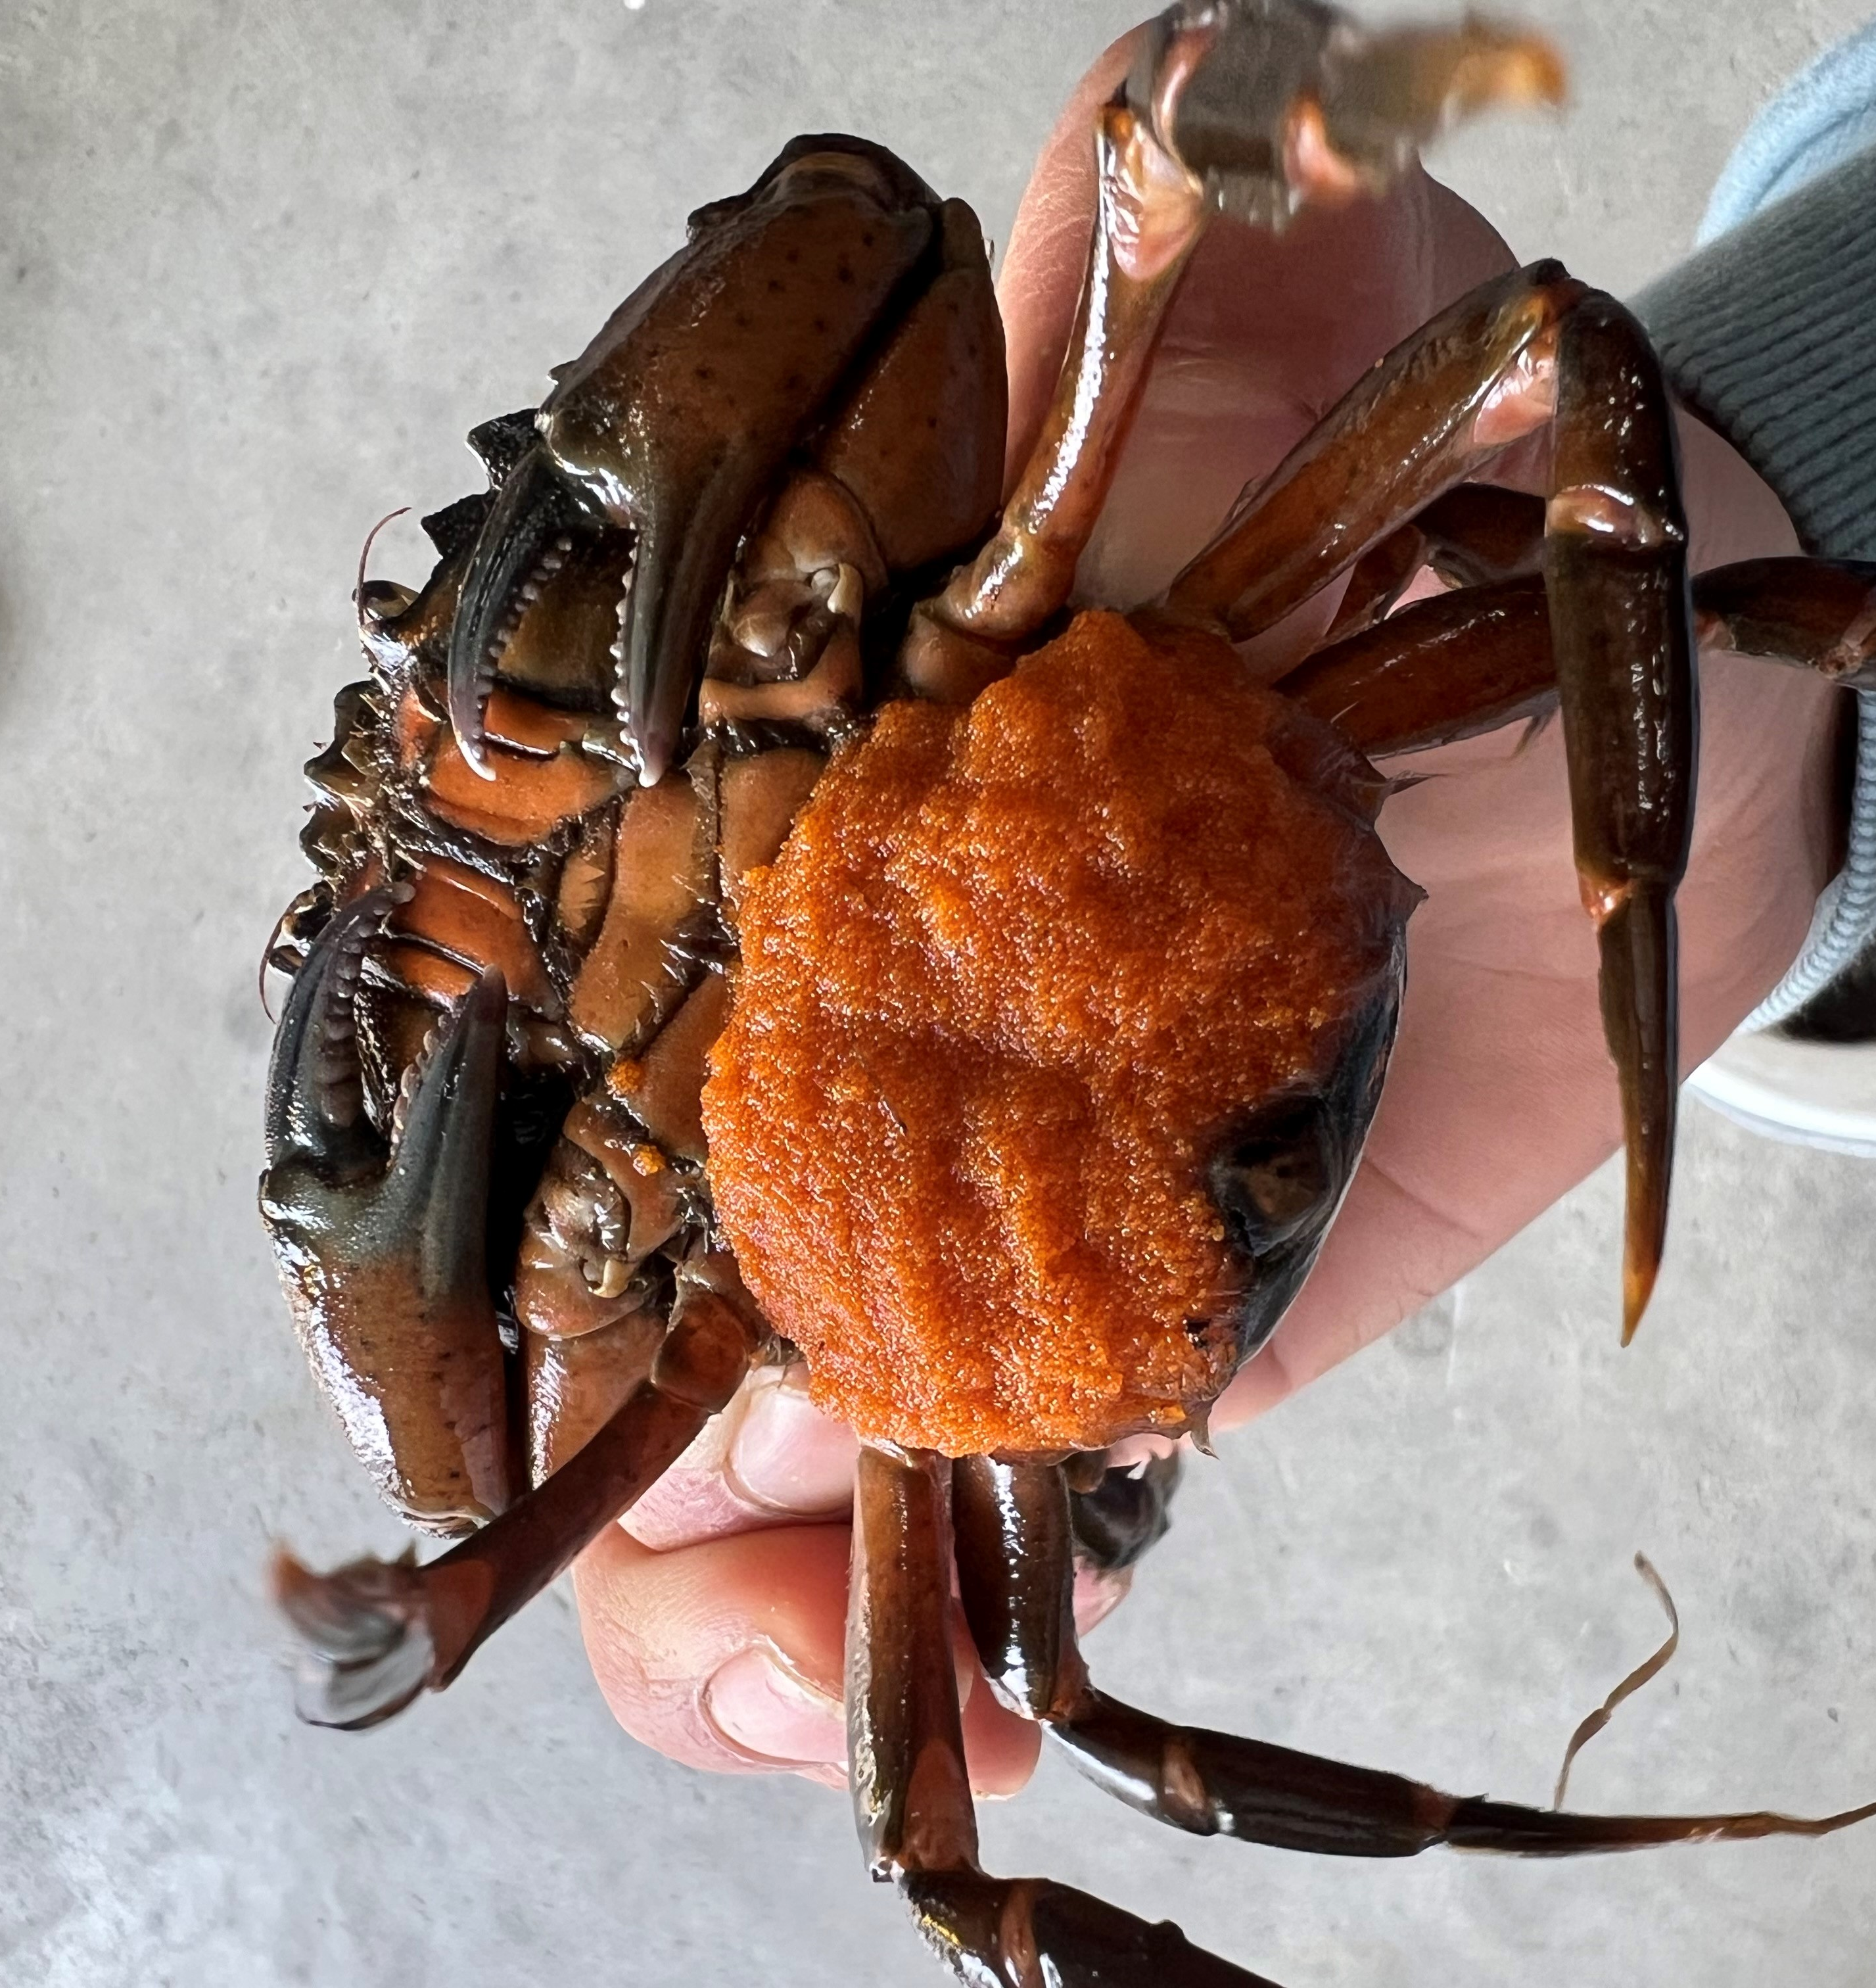
Questions?
Genelle Winter- Invasive Species Program Director, gwinter@metlakatla.com
Ian Hudson- Fisheries Biologist and Green Crab Coordinator ihudson@metlakatla.com
Nicole Reynolds- Environmental Specialist nreynolds@metlakatla.com

