Slide 1
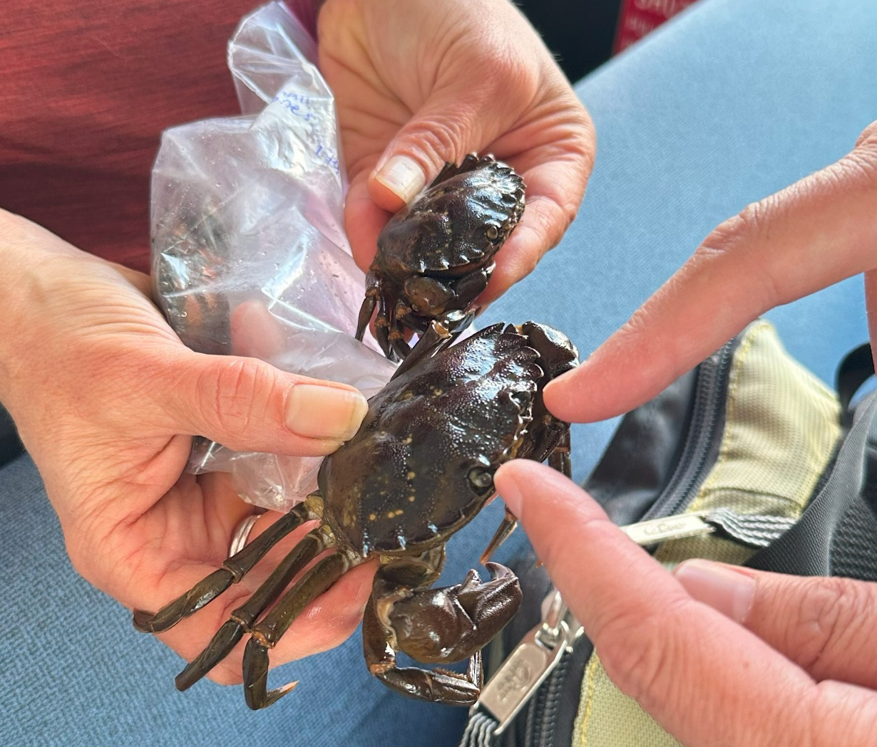


Green Crab Invasion
A Community Action Approach to Resilience Against Invasive Species in Southern Southeast Alaska
Barbara Morgan (UAS)
Charmaine Lewis (UAS)
AK TRLN September 16, 2025

Slide 2
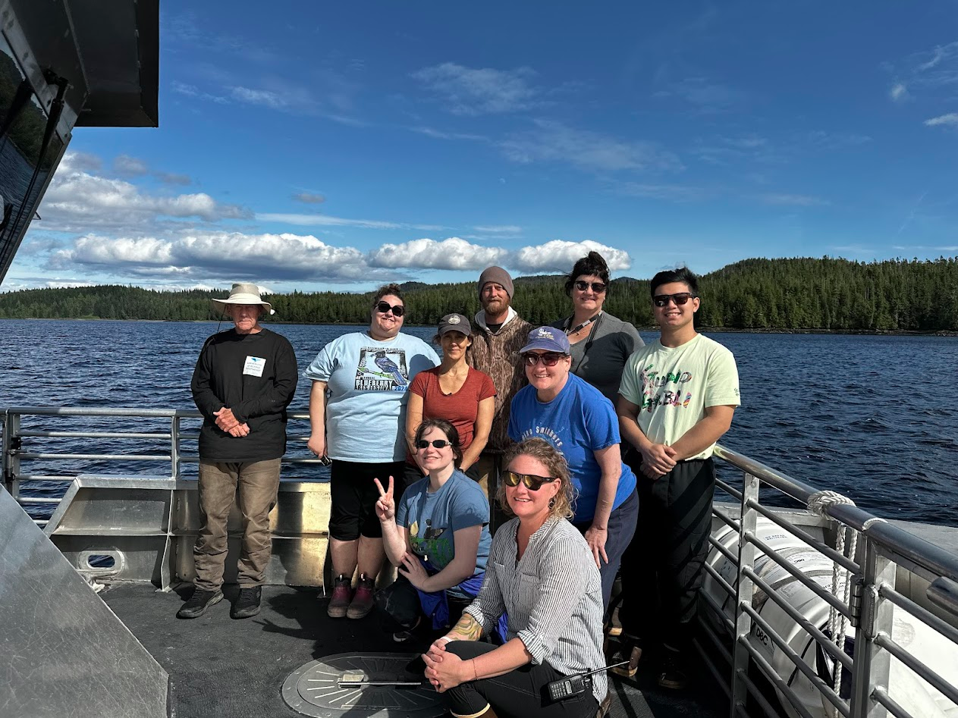
June 2025 – Community Education Class
Course Objectives
  EGC ID
  Native crab species ID
  Molt walk monitoring protocol
  Data collection & submission

Slide 3
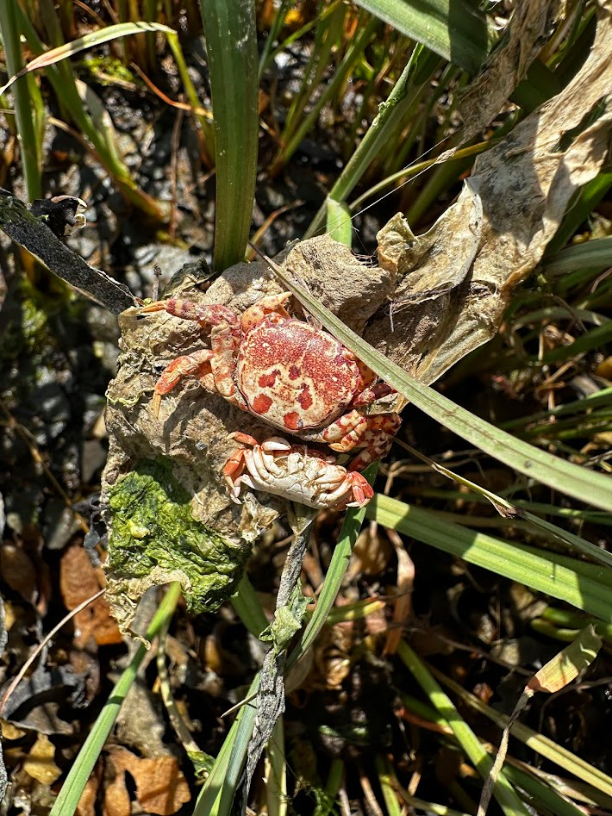
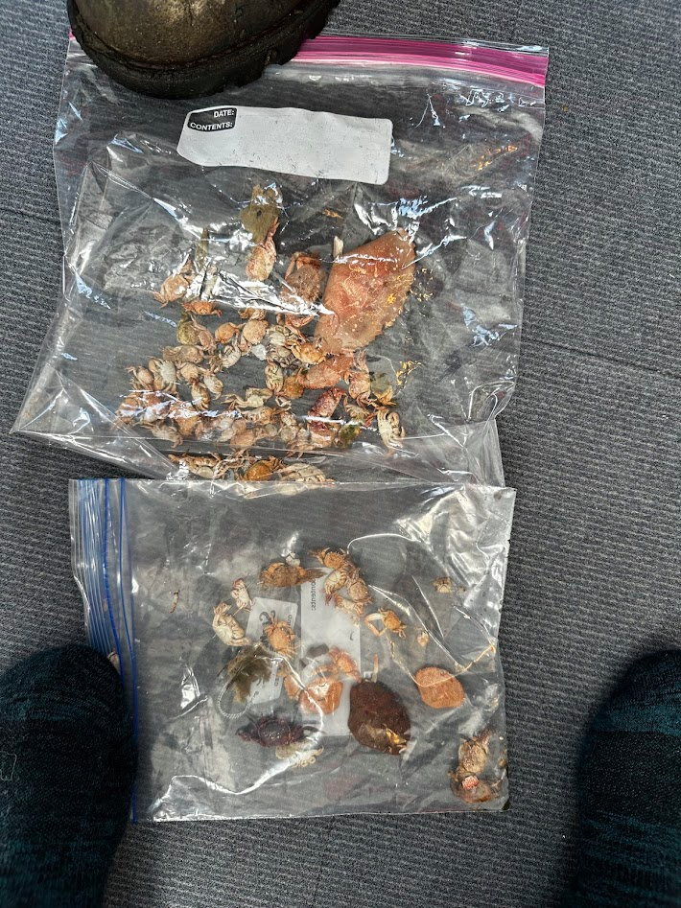
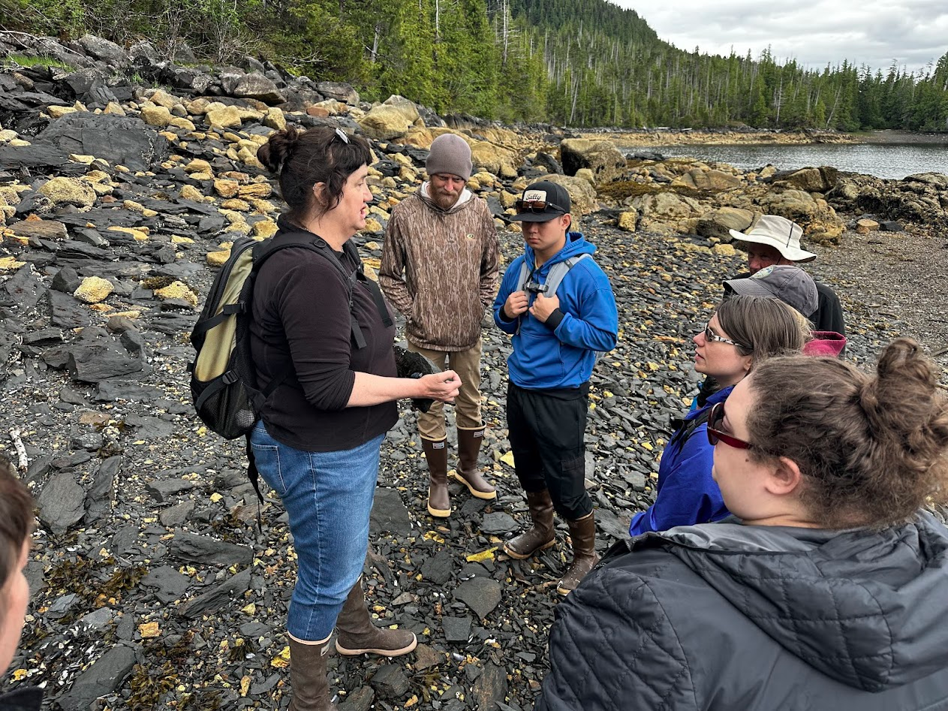
Training Citizen Scientists

Slide 4
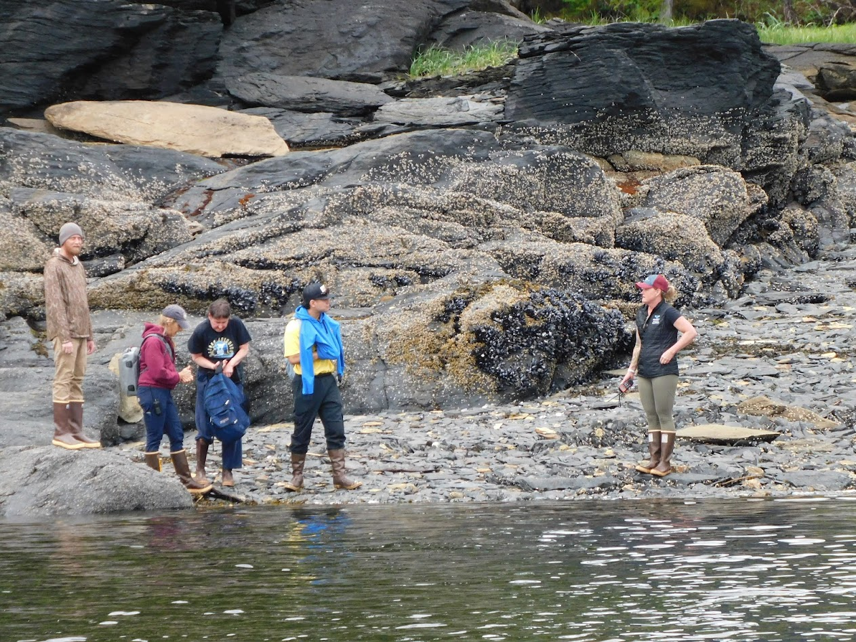
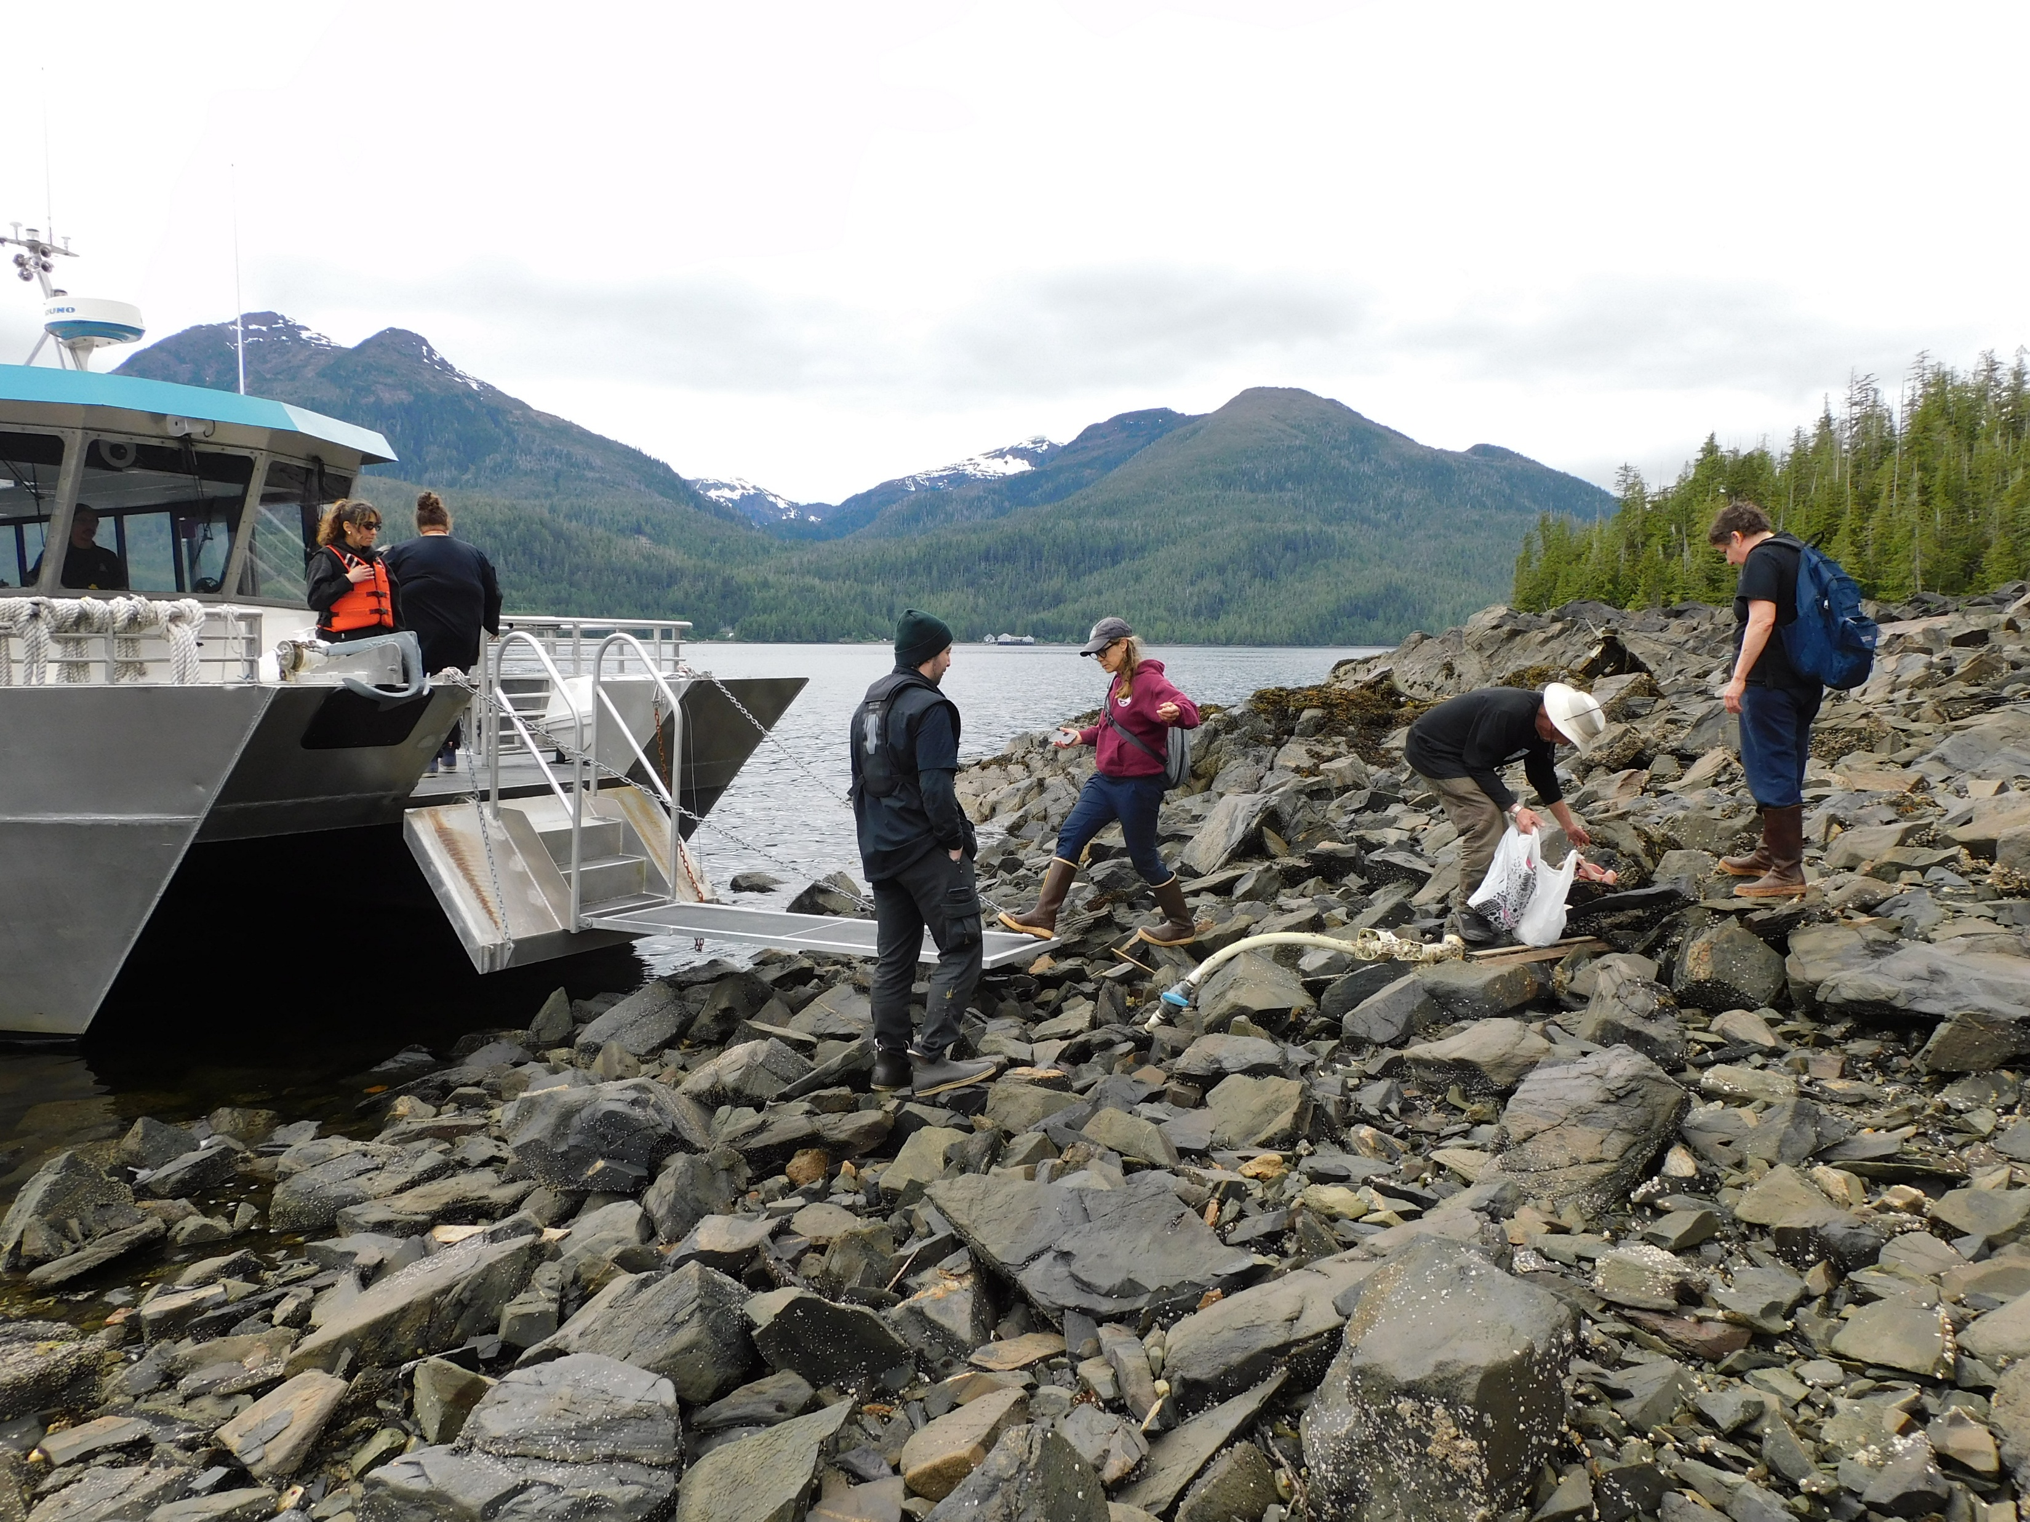
Successes & Challenges

Slide 5
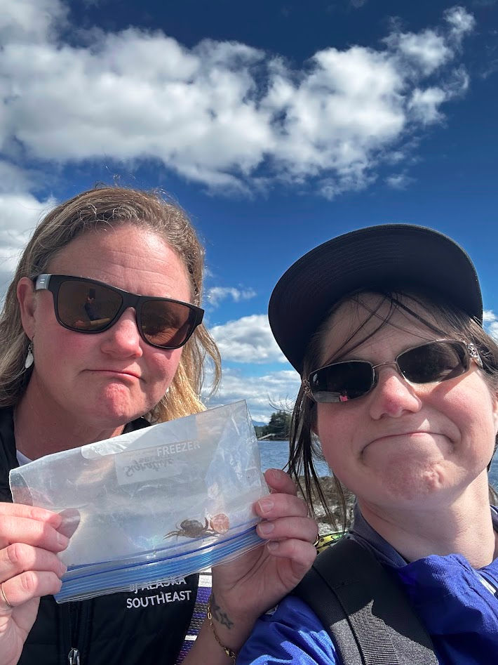
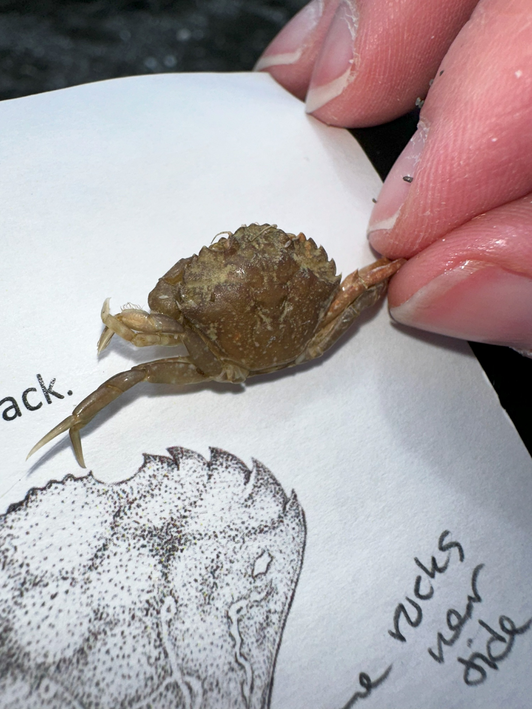
First two EGC shells found in Ketchikan area

Slide 6
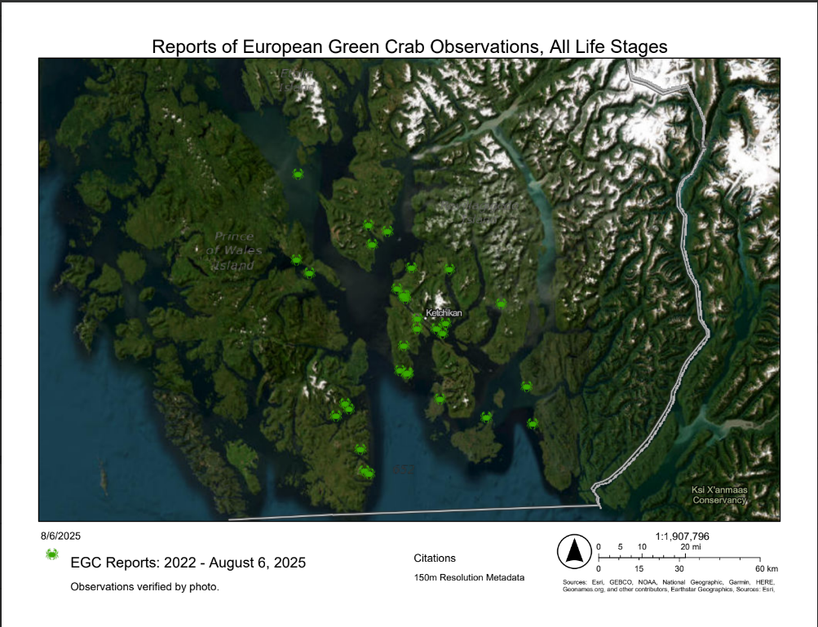

Slide 7
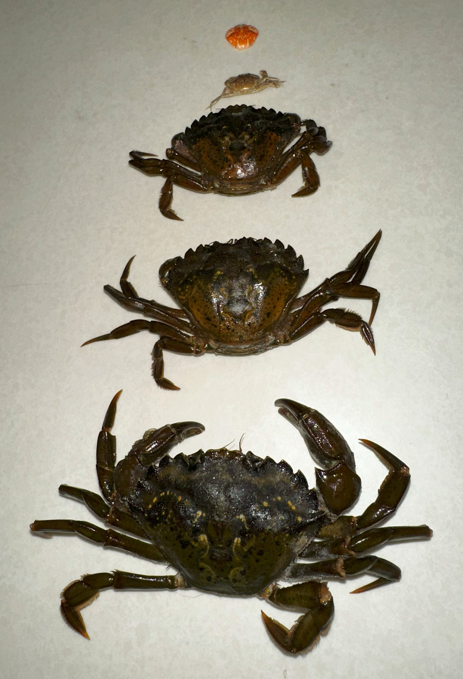
Next steps…
Focus on education
  Offer EGC class again
  Distribute educational materials
  Public Presentations and Professional Conferences
Collaborate on regulations for ADF&G Board of Fish
Continue monitoring
  Molt walks
  Live crab walks

